Slide 1
Laravel 101
@chonla
14 Mar 2014

Slide 2
Outline
Welcome to PHP
MVC Frameworks
Laravel Installation
Hello world, Laravel
Routing
Controller
Revisit Routing
Template with Blade
IoC Container
Testing with PHPUnit and Mockery
Example
Q&A

Slide 3
Welcome to PHP
A server-side scripting language
Very very popular

Slide 4
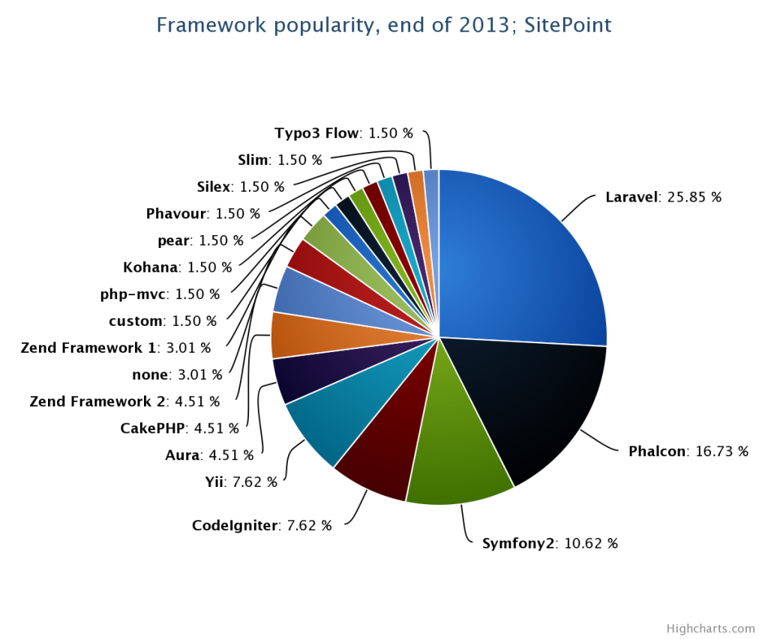
MVC Framework
Image courtesy of Bruno Skvorc : http://www.sitepoint.com/best-php-frameworks-2014/

Slide 5
Laravel Installation
Requirement
PHP >= 5.3.7 (http://www.php.net/downloads.php)
MCrypt extension
Composer (https://getcomposer.org/Composer-Setup.exe)
Laravel
Create new project : composer create-project laravel/laravel --prefer-dist

Slide 6
Laravel Installation
Confirm installation
Setup server
Apache
Map document root to to sub-directory laravel/public
PHP 5.4+
Go to sub-directory and start PHP server using command “php –S localhost:8000” to start PHP built-in server on localhost over port 8000

Slide 7
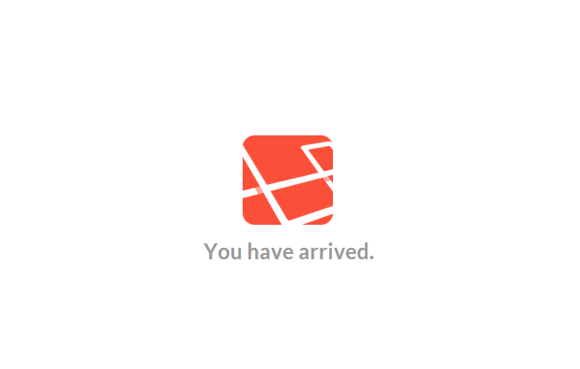
Laravel Installation
Confirm installation
Open browser and go to “http://localhost:8000”, you should see this page.

Slide 8
Hello world, Laravel
Open file laravel/app/views/home.php in text editor, clear the content, type “Hello World” and save
Refresh your browser

Slide 9
Routing
You can configure routing by modifying file laravel/app/routes.php
Predefined route, “/”, is mapped to a closure of view of hello.php
Try creating a route to “http://localhost:8080/example/one” using GET method and “Example One” is displayed on the browser

Slide 10
Routing
Routing methods and HTTP Verbs
GET = Route::get
POST = Route::post
Any = Route::any
Routing with HTTPS (PHP Built-in server does not support HTTPS)
Route::get(‘/’, array(‘https’, function() { // … }));

Slide 11
Routing
Routing with one parameter
Route::get(‘user/{name}’, function($name) { echo $name; });
Route::get(‘user/{name?}’, function($name=null) { echo $name; });
Route::get(‘user/{name?}’, function($name=‘chonlasith’) { echo $name; });

Slide 12
Routing
Routing with multiple parameters
Route::get(‘user/{id}/{name}’, function($id, $name) { echo $name . ‘(‘ . $id . ‘)’; });

Slide 13
Routing
Add some constraints to routing
Route::get(‘user/{id}’, function($id) { echo $id; })->where(‘id’ , ‘[\d]+’);
Route::get(‘user/{id}/{name}’, function($id, $name) { echo $name . ‘(‘ . $id . ‘)’; })->where(array(‘id’ => ‘[\d]+’, ‘name’ => ‘[a-zA-Z]+’));

Slide 14
Controller
Controller file is located in folder laravel/app/controllers
All controllers is derived from BaseController

Slide 15
Revisit Routing
Create routing to Controller
Route::controller(‘user’, ‘UserController’);
class UserController extends BaseController { public function getIndex() { // GET /user
}
public function postProfile() {
// POST /user/profile
}
public function getDetailedProfile() {
// GET /user/detailed-profile
}
}

Slide 16
Revisit Routing
Create resource to Controller, the easiest way to create RESTful
Route::resource(‘<route-name>’, ‘<controller-name>’);
Verb | Path | Action | Route Name
GET | /resource | index | resource.index
GET | /resource/create | create | resource.create
POST | /resource | store | resource.store
GET | /resource/{resource} | show | resource.show
GET | /resource/{resource}/edit | edit | resource.edit
PUT/PATCH | /resource/{resource} | update | resource.update
DELETE | /resource/{resource} | destroy | resource.destroy

Slide 17
Revisit Routing
Handling missing method
Add method missingMethod to the controller
public function missingMethod($parameters = array()) {
//
}

Slide 18
Template with Blade
Laravel 4 uses Blade as a template engine
Anyway, you don’t need to use Blade to render
Template structure
Layout
Define layout as a protected class member
Content
Assign content to layout using layout->content

Slide 19
Template with Blade
Example
Assign data to view
class UserController extends BaseController { protected $layout = 'layouts.master';
public function showProfile() {
$this->layout->content = View::make('user.profile');
}
}
class UserController extends BaseController { protected $layout = 'layouts.master';
public function showProfile() {
$data = array('name'=>'Somsak');
$this->layout->content = View::make('user.profile‘, $data);
}
}

Slide 20
Template with Blade
How it works?
protected $layout = ‘layouts.master’;
Tell Laravel to use file ‘app/views/layouts/master.blade.php’ as a layout
View::make(‘user.profile’, $data);
Compile view from file ‘app/views/user/profile.blade.php’ with $data as data
$this->layout->content = …
Tell Laravel to use … as content

Slide 21
Template with Blade
Blade Templating
File name must be ended with .blade.php
Directives
@extends(‘template-name’)
@section(‘section-name’) … @stop
@section(‘section-name’)…@show
@yield(‘section-name’)
…

Slide 22
Template with Blade
layout.blade.php
hello.blade.php
controller
Header<br>
@yield(‘greeting')
Footer<br>
@section(‘greeting')
Hello {{$name}}<br>
@stop
protected $layout = 'layout';
public function getGreeting() {
$data = array('name'=>'Somsak');
$this->layout->content = View::make(‘hello‘, $data);
}

Slide 23
IoC Container
Laravel uses App::make() to resolve dependencies
App::bind() to bind a type into container
App::singleton() to bind a shared type into container

Slide 24
IoC Container
Better organizing IoC binding into category by using Service Provider
Registered Service Providers are listed in app/config/app.php

Slide 25
IoC Container
Create a new service provider (package)
Fill in name and email in app/config/workbench.php first.
Use command line to initialize new package
php artisan workbench <vendor>/<package> --resources
composer install
If you found a problem “File not found”, try composer dump-autoload to fix that
Add “workbench” into classmap under autoload in composer.json

Slide 26
IoC Container
Open /workbench/<vendor>/<package>/src/<vendor>/<package>/<package>ServiceProvider.php
In method provides(), add service name into array()
Open app/config/app.php
Add '<vendor>/<package>/<package>ServiceProvider' into $providers array
For example, ‘chonla/calculator/CalculatorServiceProvider’

Slide 27
IoC Container
Next, create main class of package in the same place as CalculatorServiceProvider.php file, named Calculator.php
Now, we have just got a Service Provider
Next, we are going to introduce it to IoC Container
<?php namespace Chonla\Calculator;
class Calculator {
public static function add($a, $b){
return $a + $b;
}
}

Slide 28
IoC Container
Go back to Service Provider and update register() method as the following
public function register() {
$this->app[‘calculator’] = $this->app->share(function($app)
{
return new Calculator;
});
}

Slide 29
IoC Container
Create a new folder named Facades in your package directory and add a file named Calculator.php to Facades folder
And add this code to the end of $alias variable in app/config/app.php file
<?php namespace Chonla\Calculator\Facades;
use Illuminate\Support\Facades\Facade;
class Calculator extends Facade {
protected static function getFacadeAccessor() { return ‘calculator'; }
}
'Calculator‘ => 'Chonla\Calculator\Facades\Calculator',

Slide 30
IoC Container
Reload package into your project with command line : composer dump-autoload
Now you will be able to access your package through this new Façade, like this
echo Calculator::add(4, 5);

Slide 31
Testing with PHPUnit and Mockery
Install PHPUnit and Mockery
Add the following lines into composer.json
Run command line : composer update to install new dependencies
"require-dev": {
"phpunit/phpunit": "3.7.*",
"mockery/mockery": "dev-master"
},

Slide 32
Testing with PHPUnit and Mockery
Create a test file name CalculatorTest.php under workbench\chonla\calculator\tests
<?php
use Chonla\Calculator\Calculator;
class CalculatorTest extends TestCase {
function testZeroPlusZeroShouldBeZero() {
$expected = 0;
$result = Calculator::add(0, 0);
$this->assertEquals($expected, $result);
}
}

Slide 33
Testing with PHPUnit and Mockery
Run your first test by command line:
vendor\bin\phpunit .\workbench\chonla\calculator\tests\CalculatorTest.php

Slide 34
Example
A Calculator

Slide 35
Q&A

Slide 36
References
http://laravel.com/docs
http://culttt.com/2013/06/24/creating-a-laravel-4-package/
https://github.com/padraic/mockery

